Slide 1


Chicken Disease Classification using Deep Learning
Detecting Coccidiosis-affected and healthy chickens from fecal images.
Presented By
Swapnil Halder
ID :0562210005101001

Slide 2

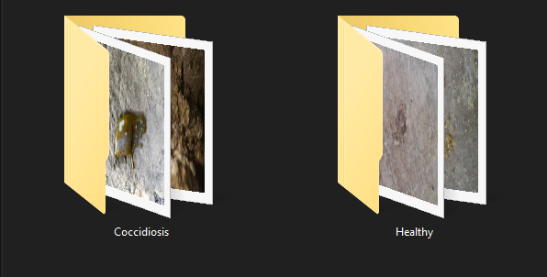
Project Objective
Objective: Healthy vs Coccidiosis classification
Input: Chicken fecal image
Output: Prediction (Healthy / Coccidiosis)

Slide 3
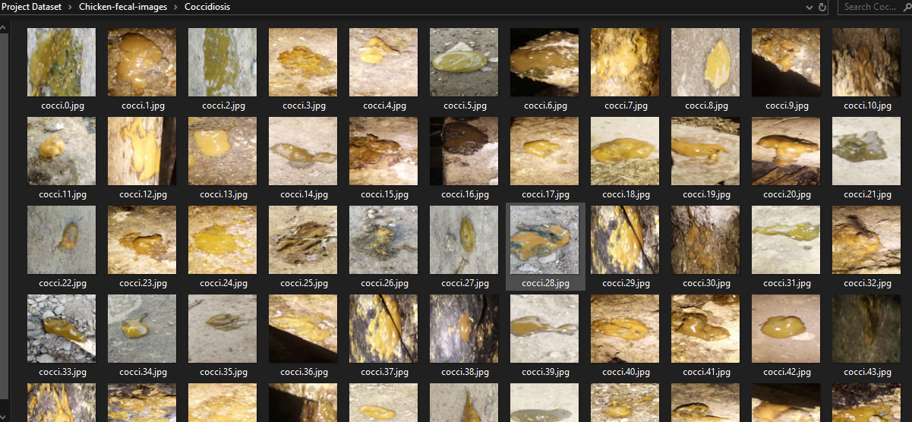
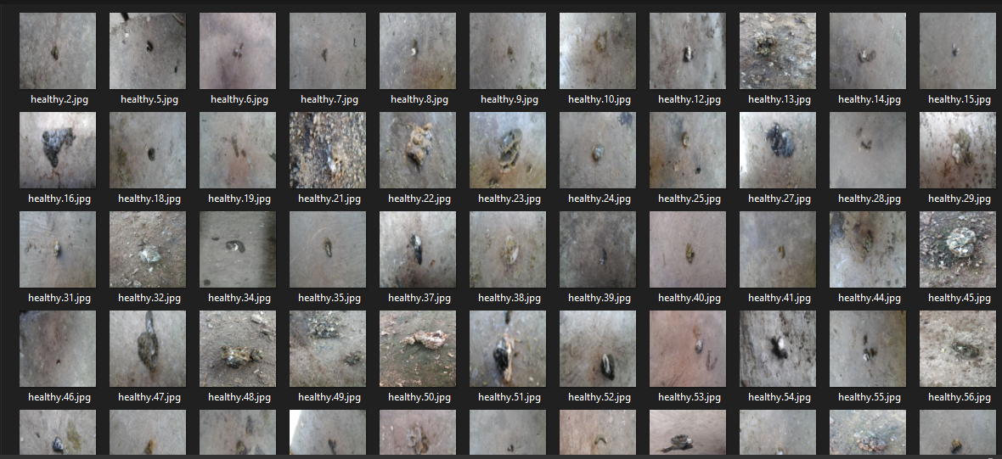
Coccidiosis
Dataset Overview
Total images: 390 images
Classes: Healthy, Coccidiosis
Image size: Resized to 224×224
Data split: Train: 70%, Test: 30%
Healthy

Slide 4
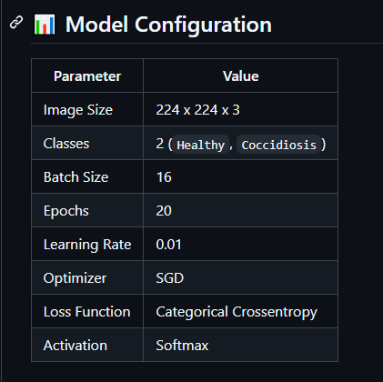

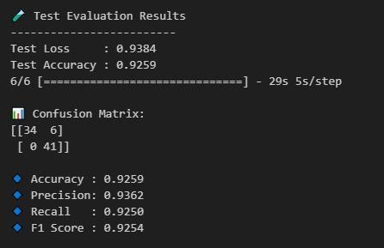
Model & Accuracy
Used VGG16 with Transfer Learning
Optimizer: SGD (lr=0.01)
Epochs: 20
Accuracy: 92%

Slide 5
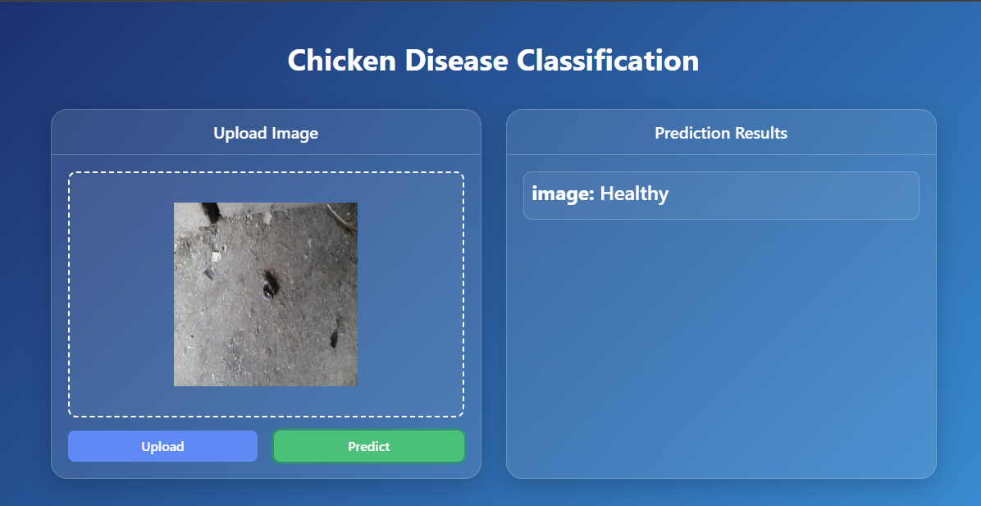
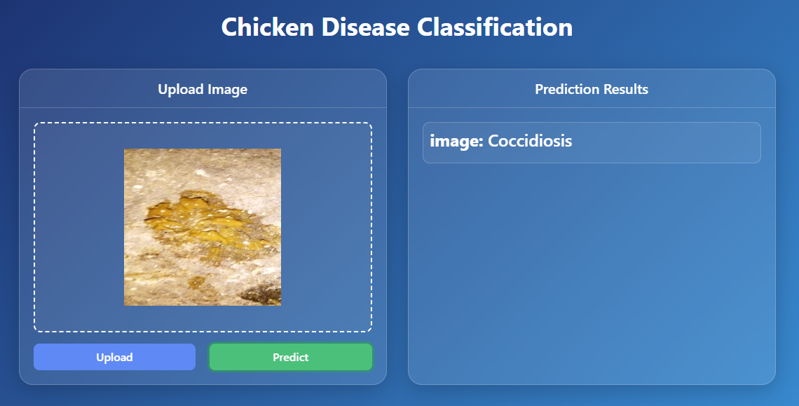
Localhost Deployment
Feature: Upload image → Get prediction

Slide 6
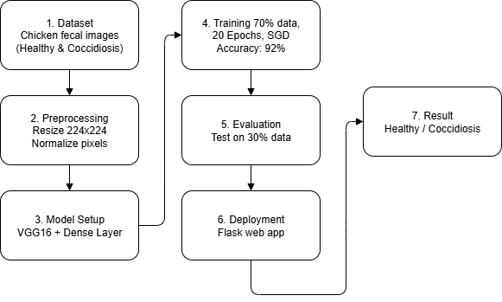
Project Workflow

Slide 7
Conclusion & Future Work
Summary : A lightweight deep learning model for early chicken disease detection.
Future Work :
Expand dataset for better generalization
Extend model to detect more poultry diseases

Slide 8

GitHub
https://github.com/swapnilhalder01/chicken-disease-classification-deep-learning-project

Slide 9

Thank You.

